Slide 1
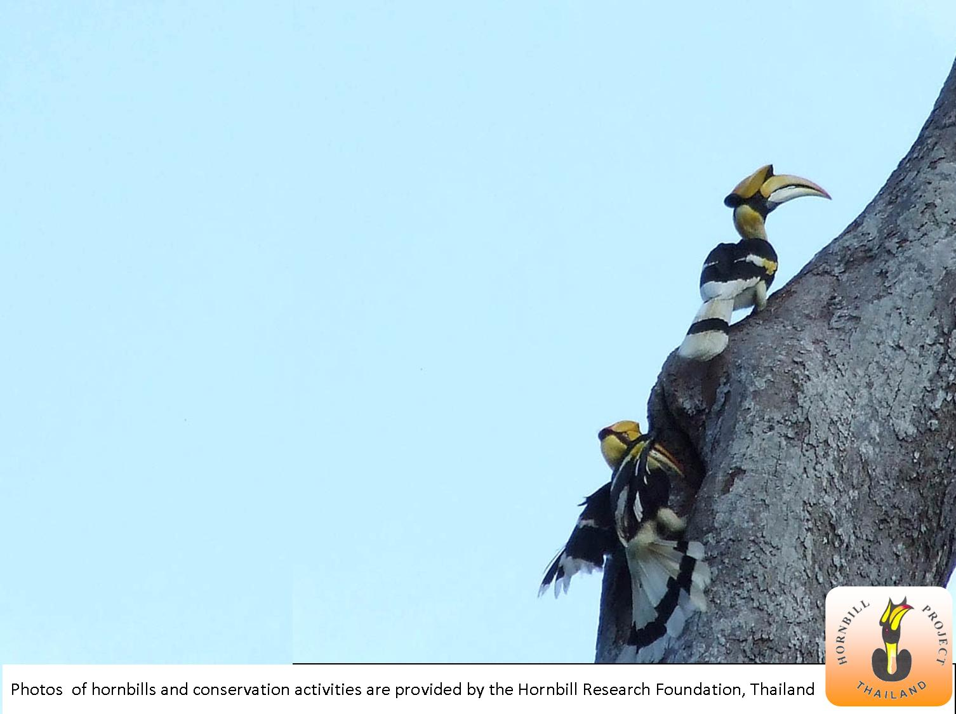
Index Insurance for Pro-poor
Biodiversity Conservation:
The Case of Hornbills
in Southern Thailand
Pin Chantarat, Tavan Janvilisri, Chularat Niratisayakul,
Sittichai Mudsri, Pilai Poonswad and Chris Barrett
Biodiversity and Poverty Traps
Workshop, Cornell University
February 5, 2010

Slide 2
Insurance, Conservation and Rural Poverty
Environmental and economic costs of uninsured (weather and natural disaster) risk, esp. w/ threshold-based traps
Insurance → rural livelihood and poverty:
  Provide ex post safety net to prevent downward slide of vulnerable populations
  May encourage investment and asset accumulation by the poor
  May induce financial deepening by crowding-in credit market
Insurance → pre-finance rapid rehabilitation and recovery:
  Ensure adequate, timely response that enhances resilience to shocks so as to prevent species/system collapse
When shocks are strongly linked to livelihood and ecosystem dynamics, insurance for cash-for-conservation work can
  Provide safety net for both people and endangered species
  Replace predatory behaviors with restorative behaviors as a way to cope with shocks.

Slide 3
The Potential of Index Insurance
Conventional insurance unlikely to work due to transaction costs and incentive problems (moral hazard and adverse selection)
Index insurance w/ indemnity payments based on “an index”
  Objectively verifiable, available at low cost in real time
  Not manipulable by either party to the contract
  Strongly correlated with covariate risk being insured
  No transactions costs of measuring individual losses
  Preserves effort incentives (no moral hazard) as insured cannot influence index
  Available on near real-time basis: faster indemnity payment for more effective recovery response
Pre-requisite: strong correlation established from sufficiently high-quality data of insurable risk (the index)

Slide 4
This paper
Explores a novel application of index insurance for pro-poor biodiversity conservation
Illustrates using community-based hornbill conservation in Budo Su-Ngai Padi National Park (BSNP), southern Thailand
  Strong winds (e.g., tropical storms) are a key threat to both endangered hornbill reproduction and to rural livelihoods
  Human disturbance to hornbills also induced by adverse wind-related shocks, so need to break the vicious cycle
Data:
  Hornbill annual nest loss and reproduction data (1994-2009) from Hornbill Research Foundation, Thailand
  Per capita village consumption (6 villages, 1998-2006) from Thailand National Statistical Office
  Wind speed data (1980-2009) from Thai MET Department

Slide 5
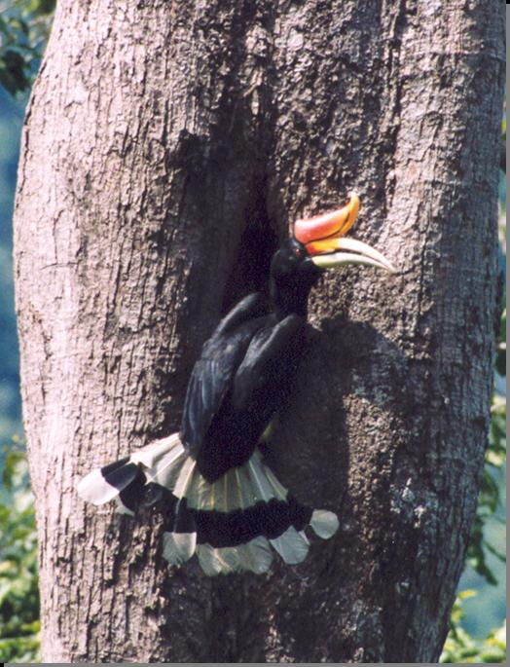
Hornbills and Rural Livelihood in Budo Su-Ngai
Padi National Park (BSNP)
Mountainous, tropical rainforest with >2,400 mm of annual rain
Home to 6 endangered species of hornbills (density of 20.3/km²)
Dry season (Feb-July) vs. rainy season (Aug-Jan) with >2400mm. annual
rainfall, sensitive to tropical storms
Nesting season (Feb-Sept) each year
Stable reproduction (population) relies on
(1) Availability of suitable nest trees
  - Holding capacity for breeding pairs
  - Storms as key cause of irreversible loss
(2) Breeding condition free of disturbance
  Key threat: extensive human disturbance (poaching, forest clearance), some induced by coping responses to adverse income shocks as key threat to breeding success

Slide 6
Hornbills and Rural Livelihood in Budo Su-Ngai
Padi National Park (BSNP)
Home to Muslim minorities (among Thailand’s poorest groups):
Hornbill research foundation and
conservation project (since 1994):
Poverty rates ($1.25/day) ~ 43-89%
Heavily forest-dependent livelihood,
vulnerable to weather shock
- 40-60% relying on rain-fed agri.
- Agri. lands predominated by rubber,
embedded within the BSNP
Collect annual data on nest
and reproduction variables
Focus on nest modification and
replacement (e.g., artificial nests)
Extensive community involvement
aiming to reduce human disruptions

Slide 7
Wind-based Index Insurance for Pro-poor Hornbill Conservation: General Framework
Accumulation of nest trees
Irreversible nest tree loss
Effective nest recovery response
Wind-based index
Insurance for nest tree
based on
Hornbill population dynamics
Strong winds
shock
Community-based
nest recovery program
Rural village consumption
Reduce human disturbance
Induced by adverse
Consumption shock

Slide 8
Wind-based Index Insurance for Pro-poor Hornbill Conservation: Results of Predictive Relationships
Two constructed wind variables:
  w_{t} annual maximum wind speed
  cw_{t} cumulative monthly maximum wind speeds that exceed the
  month-specific long-term average
(1) Total nest tree loss (% total available):
Endogenous regime switching with κ = 25 knots
Model predicts nest loss well in the bad regime
Predicted nest loss captures history well
,

Slide 9
Wind-based Index Insurance for Pro-poor Hornbill Conservation: Results of Predictive Relationships
(2) Village per capita consumption
Weighted least square of 6 villages in biennial
survey period (1998-2006)
Elasticity of village consumption wrt.
cumulative intensity of severe wind = 0.35

Slide 10
Wind-based Index Insurance for Pro-poor Hornbill Conservation: Results of Predictive Relationships
Evidence that villagers cope with wind storm shocks by disturbance to hornbills
(3) Breeding success (% of total fledged chicks from total nest trees available )
High correlations between breeding success and lagged consumption = 0.77
Cannot directly estimate this due to limited village consumption data availability
Strong effects of lagged wind speeds on breeding success include both induced disturbance and any others, much of which is storm-induced anthropogenic pressure

Slide 11
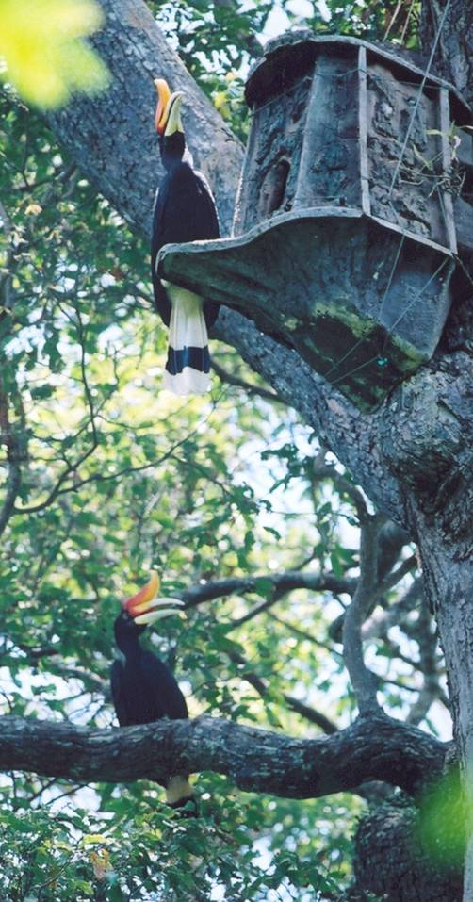
Wind-based Index Insurance for Pro-poor Hornbill Conservation: Contract Specifications
How would this insurance work?
Conservation project can insures any T nest trees
If wind-based nest loss index exceeds strike l*, insurance payout can finance rapid community-based nest replacement (e.g., artificial nests)
c: total replacement cost per tree nest (artificial nest =$400, installation and annual monitoring by local villager = $600, which goes directly to villager)

Slide 12
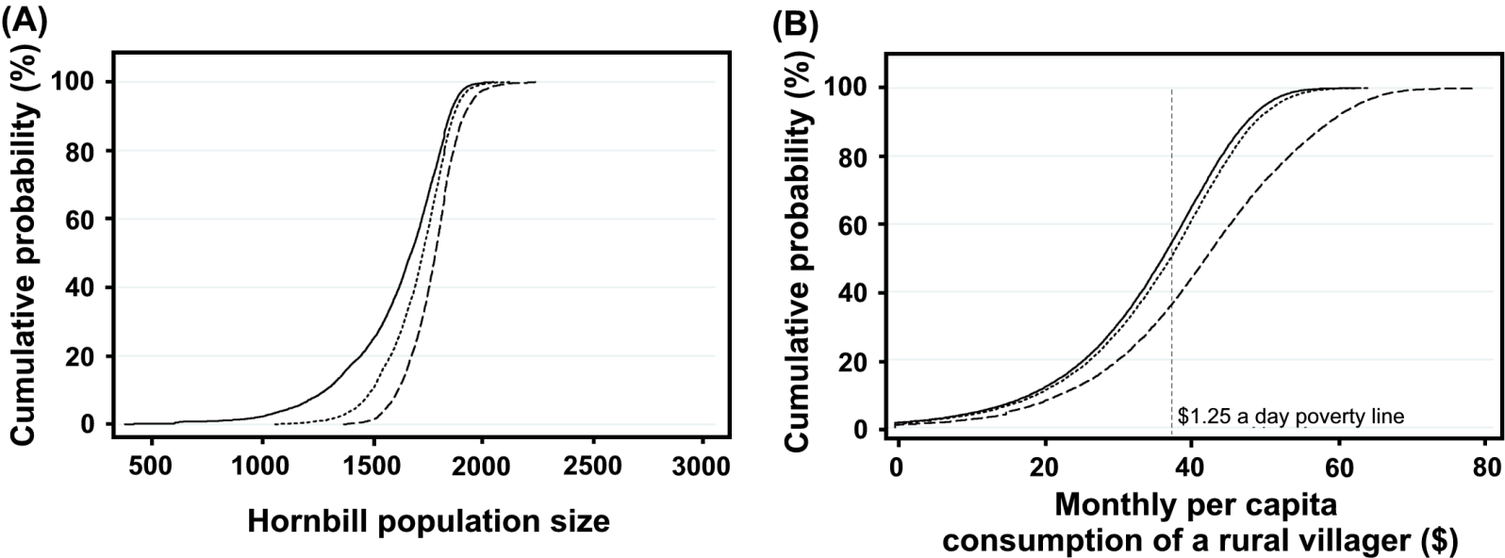
Wind-based Index Insurance for Pro-poor Hornbill Conservation: Simulated Evaluation
Assume that project insures all nest trees at the beginning of any year t, and that each villager receives $600/12 = $50 for full installation and monitoring of an artificial nest
5% contract would reduce prob. of flock collapse below initial size (1827) by from 80% to 60% and eliminate prob. of collapse below 1500.
It would reduce poverty headcount ($1.25/day) by 20%
Cumulative distributions of 1000 replications of 100-yr simulated dynamics
(line= no insurance, dash = 5% strike contract, dot = 15% strike contract)

Slide 13
Discussion
Index insurance shows promise as a mean to manage weather and natural disaster risk (which commonly affects conservation outcomes and rural livelihoods that depend on natural resources)
In the case of hornbill conservation, wind-based index insurance:
  Can enable project to finance community-based nest recovery program for rapid restore of necessary nesting capacity
  Provide disaster support to storm-affected rural villager s
  Potentially reduce human disruption to hornbill breeding success
Opportunities provided by index insurance could widely apply:
  When both people and biodiversity are threatened by a common, measurable shock
  Where there exists high-quality longitudinal data on an insurable interest (nest trees) and a reliable weather or covariate risk index (cost effective, objectively verifiable in near real time)

Slide 14
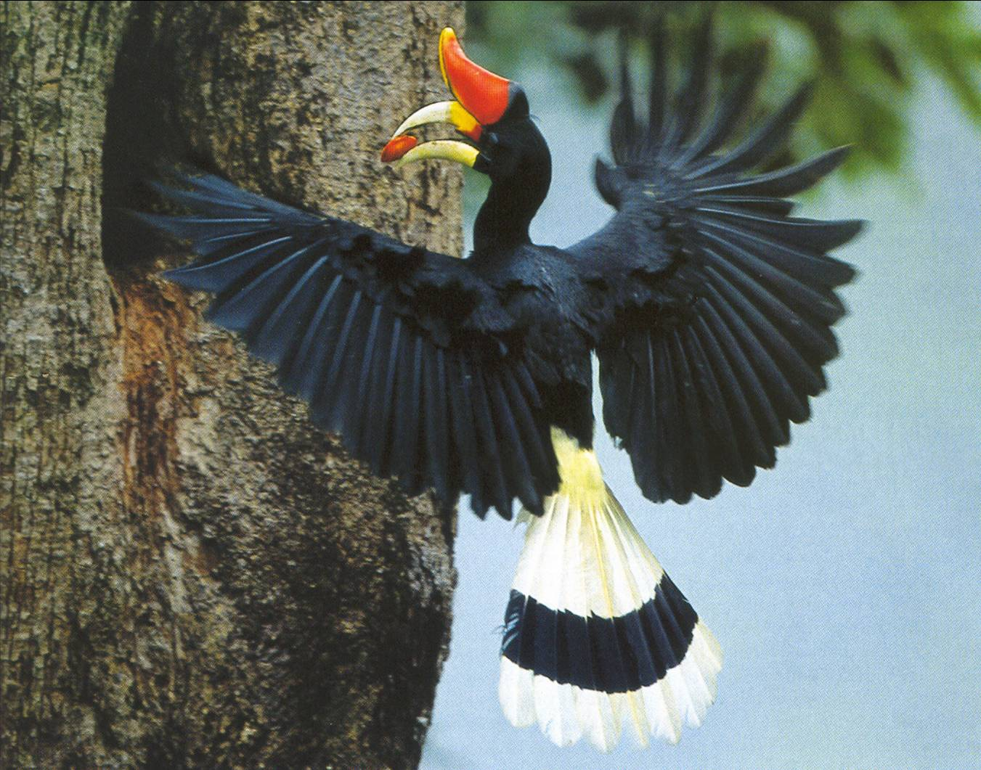
Thank you
for your attention

Slide 15
Back Up

Slide 16
Summary of Nesting Cycle and Density in BSNP
Back>>

Slide 17
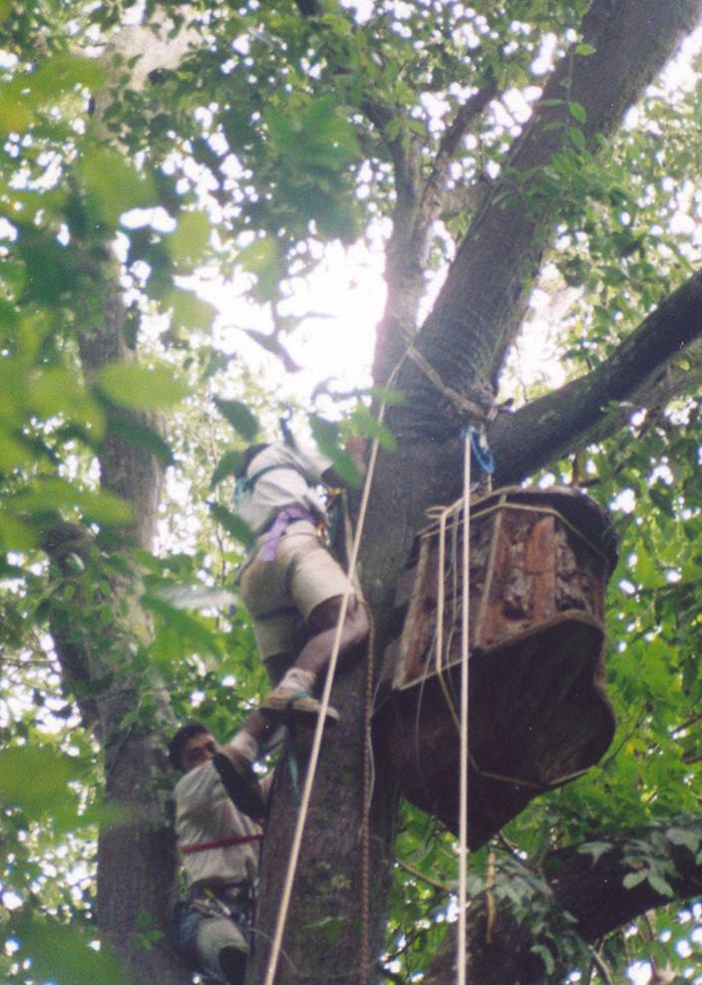
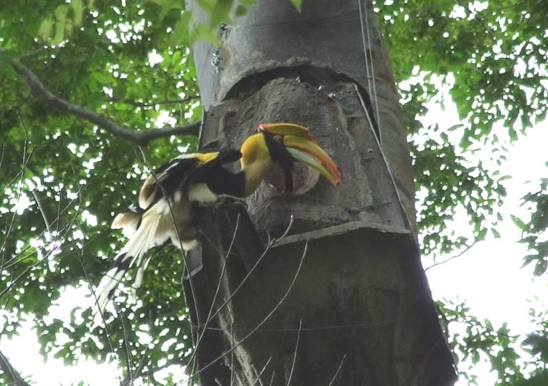
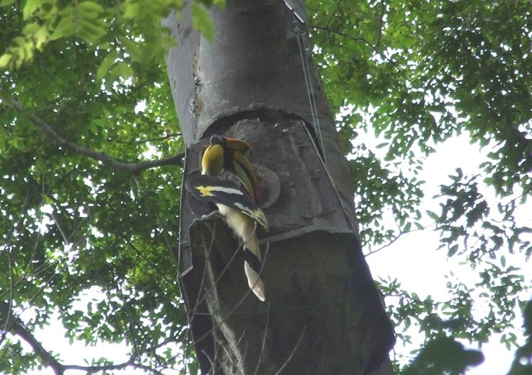
Artificial nest installation and Use by hornbills
Back>>

